Slide 1


The Rapid Advancements of AI Pros and Cons
~ Sandeep Kasturi
~ MD. Moulali

Slide 2
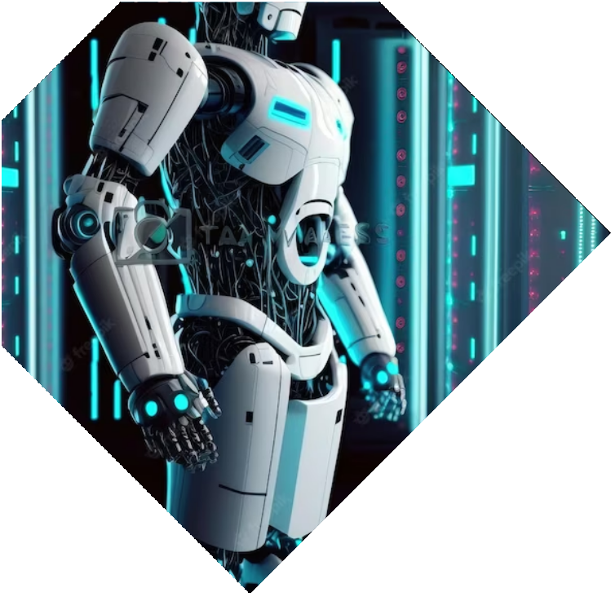


Introduction
Artiﬁcial Intelligence (AI) is rapidly advancing and changing the world around us. As we move towards an age of automation and machine learning, it's important to understand the pros and cons of this technology and how it will shape our future.

Slide 3

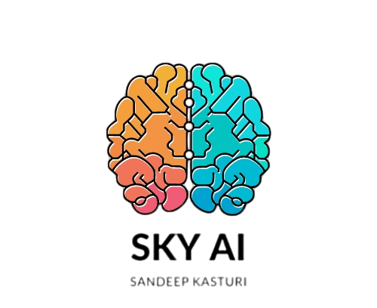



Pros of AI
AI has the potential to revolutionize healthcare, agriculture, transportation, and many other industries. It can help us solve complex problems, improve efﬁciency, and enhance decision-making. Data-driven insights can lead to better outcomes and a more sustainable future. For example ChatGPT and my AI SKY-AI

Slide 4


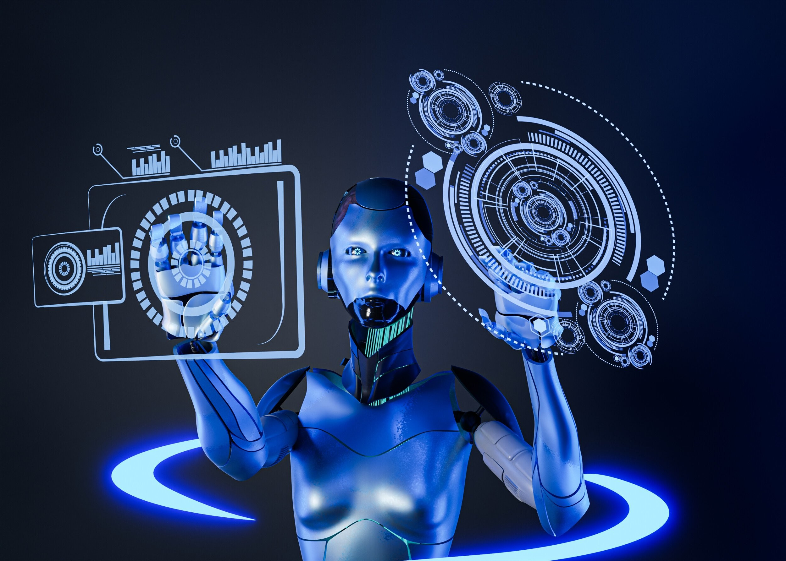

Cons of AI
However, there are also potential downsides to AI. It could lead to job displacement, economic inequality, and privacy concerns. There are also ethical dilemmas surrounding the use of AI in decision-making and bias in algorithms. We need to be aware of these risks and address them proactively.

Slide 5
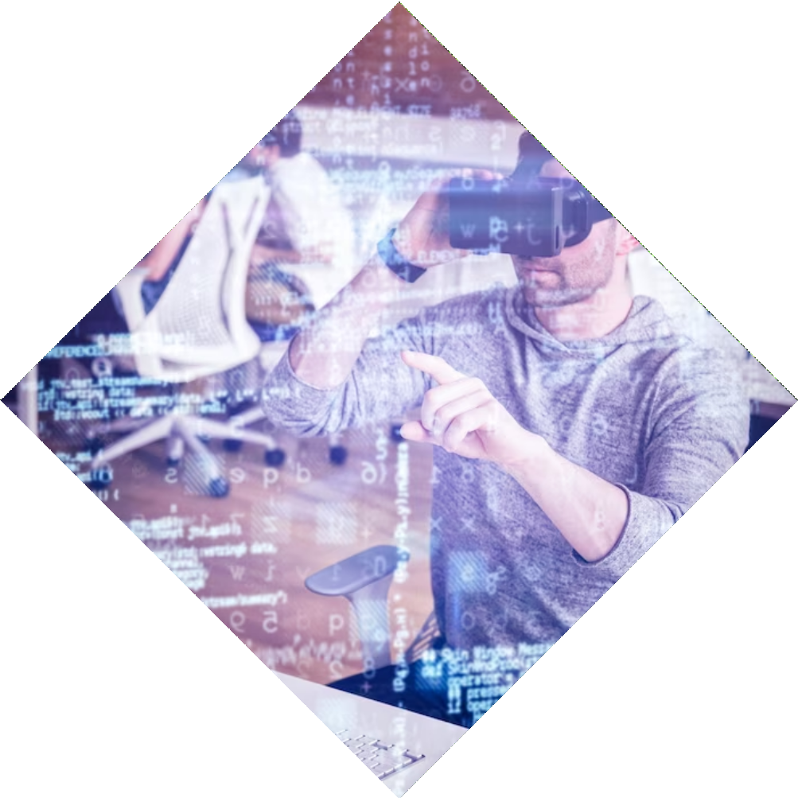



AI and the Workforce
One of the biggest concerns about AI is its impact on jobs. While it may lead to job displacement in some industries, it can also create new opportunities in others. Upskilling and reskilling will be crucial for workers to adapt to the
changing job market.

Slide 6
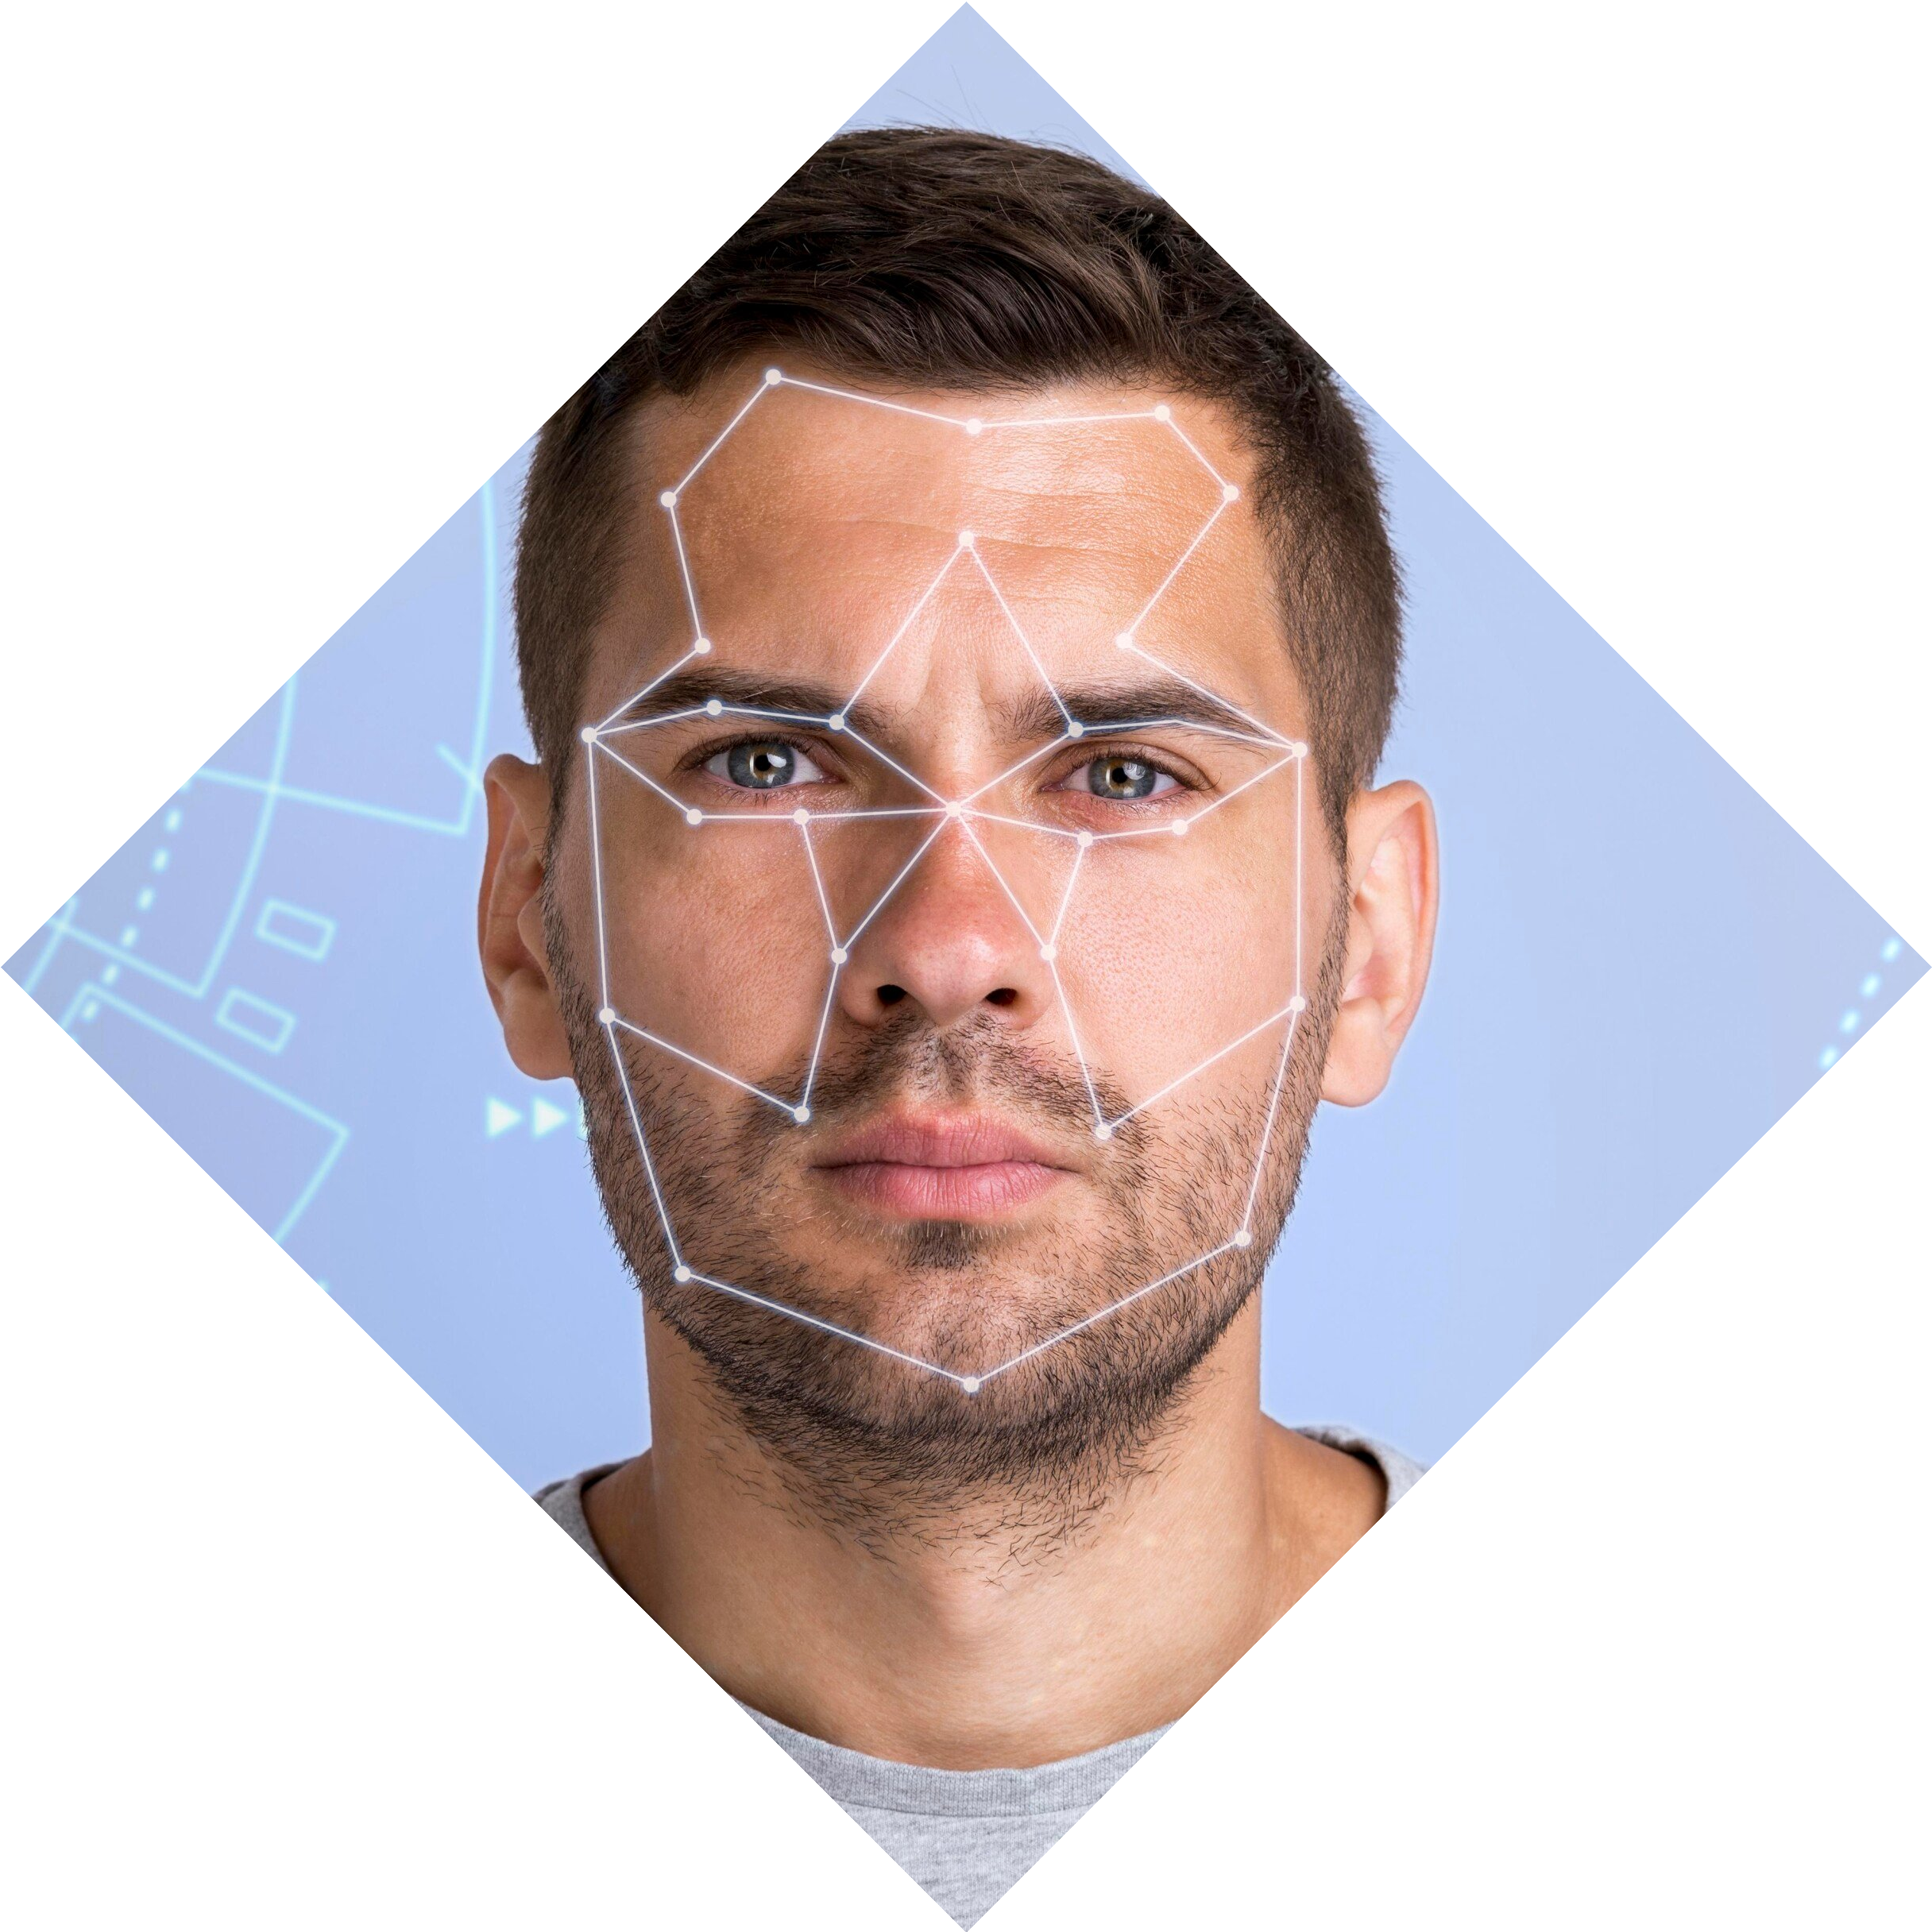


Regulating AI
As AI becomes more integrated into our lives, it's important to have regulations in place to ensure it is used ethically and responsibly. This includes transparency in decision-making and accountability for the outcomes of AI systems.
Collaboration between policymakers, industry leaders, and the public is key.

Slide 7
Conclusion
The future of AI is both exciting and uncertain. While it has the potential to transform our world in positive ways, we must also be aware of the risks and challenges that come with rapid advancements. By working together to address these issues, we can create a future where AI beneﬁts everyone.

Slide 8
Thanks
21 BATCH DCME-3C SECTION

